Slide 1



Learn More

Slide 2



OS-Climate Agenda
Introduction
Physical Risk & Resilience
Sector Alignment / Implied Temperature Rise
Transition Analysis
Climate Risk Data Mesh
Data Commons
Data Exchange
Supporting Tools
Data Extraction
Entity Matching

Slide 3























Members & Partners
PREMIUM MEMBERS
OS-Climate
Members & Partners
GENERAL MEMBERS
ASSOCIATE MEMBERS
PARTNERS & DATA PROVIDERS
World Resources Institute

Slide 4

Introduction
May 2023

Slide 5



Physical Risk & Resilience Intro

Slide 6

Physical Risk & Resilience Tool and Demo

Slide 7


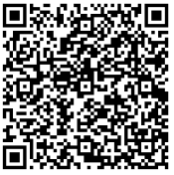
Sector Alignment (Implied Temperature Rise)

Slide 8


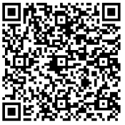
Transition Analysis

Slide 9
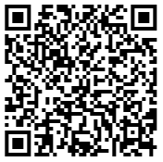
Climate Risk Data Mesh
Data Commons
Data Exchange
Data Extraction

Slide 10


Entity Matching

Slide 11

Contact Us

